Slide 1


Slide 2
There’s future glory coming
Romans 8:18-27

Slide 3
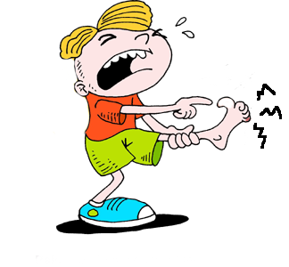
Two major themes
Suffering and Glory
“I consider that our present sufferings are not worth comparing with the glory that will be revealed in us” (v18)

Slide 4
Two major themes
Suffering and Glory
Creation is waiting (v19)
Creation is frustrated (v20)
Creation will be liberated (v21)

Slide 5
The Bible’s megastory

Slide 6
The Holy Spirit helps us to pray
Groaning and hoping
“We know that in all things God works FOR the good of those who love him” (v28)

Slide 7


Slide 9
Lord, give me I pray:
A remembering heart for the things that have happened
An attentive heart to what I have learned
A forgiving heart for what has hurt
A grateful heart for what has blessed

Slide 10
A brave heart for what may be required
An open heart to all that may come
A trusting heart to go forth with You
A loving heart for You and all your creation
A longing heart for the reconciliation of all things and
a willing heart to say “Yes” to what You will.

