Slide 1

Small groups
Use welcome card or email smallgroups@victoriabaptist.org.uk

Slide 2
Membership
Use welcome card or email membership@victoriabaptist.org.uk

Slide 3
Discovery morning
Discover skills & gifts
31st May 10.00am – 2.00pm
Use welcome card or email discovery@victoriabaptist.org.uk

Slide 4
Are we just … fakes
Spotting the real thing

Slide 5
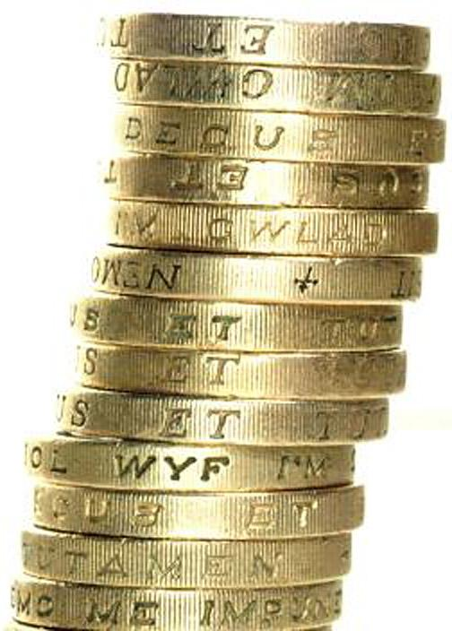
coins

Slide 6
Imitations
Galatians 1
What produces fake faith
Pluralism
Universalism
Sincerity alone

Slide 7
Tables
What life situations might show up fake faith?

Slide 8
What reveals fake faith?
Persecution
Pain
Seeing the real thing

Slide 9
Tables
What constitutes genuine Christian faith?

Slide 10

What constitutes genuine Christian faith?
Actions

Slide 11
Matthew 7:21-23
"Not every one that says to me, ‘Lord, Lord’, will enter the kingdom of heaven; but he that does the will of my Father who is in heaven. Many will say to me in that day, Lord, Lord, have we not prophesied in thy name? and in your name have cast out devils? and in your name done many wonderful works? But I will say to them, “I never knew you: depart from me, you who work iniquity."

Slide 12
What constitutes genuine Christian faith?
Actions
Beliefs

Slide 13
Apostles’ Creed – 12 tweets
1. I believe in God the Father, Almighty, Maker of heaven and earth:
2. And in Jesus Christ, his only begotten Son, our Lord:
3. Who was conceived by the Holy Ghost, born of the Virgin Mary:
4. Suffered under Pontius Pilate; was crucified, dead and buried: He descended into hell:
5. The third day he rose again from the dead:
6. He ascended into heaven, and sits at the right hand of God the Father Almighty:

Slide 14
Apostles' Creed – 12 tweets
7. From thence he shall come to judge the quick and the dead:
8. I believe in the Holy Ghost:
9. I believe in the holy catholic church: the communion of saints:
10. The forgiveness of sins:
11. The resurrection of the body:
12. And the life everlasting. Amen.

Slide 15
What constitutes genuine Christian faith?
Actions
Beliefs
Character

Slide 16
Galatians 5:19-22
The acts of the flesh are obvious: sexual immorality, impurity and debauchery; ²⁰ idolatry and witchcraft; hatred, discord, jealousy, fits of rage, selfish ambition, dissensions, factions ²¹ and envy; drunkenness, orgies, and the like. I warn you, as I did before, that those who live like this will not inherit the kingdom of God.
²² But the fruit of the Spirit is love, joy, peace, forbearance, kindness, goodness, faithfulness, ²³ gentleness and self-control. Against such things there is no law. ²⁴ Those who belong to Christ Jesus have crucified the flesh with its passions and desires. ²⁵ Since we live by the Spirit, let us keep in step with the Spirit.

Slide 17
What constitutes genuine Christian faith?
Actions
Beliefs
Character

Slide 18
All three are essential
If I have just actions – I’m nothing more than a good person
If I have only beliefs – I’m nothing more than a religious person
If I have only character – I’m nothing more than a nice person

Slide 19
What constitutes genuine Christian faith?
Actions
Beliefs
Character

Slide 20
Coins – and the fakes were …
F
N
S

Slide 21
Prayer

