Slide 1
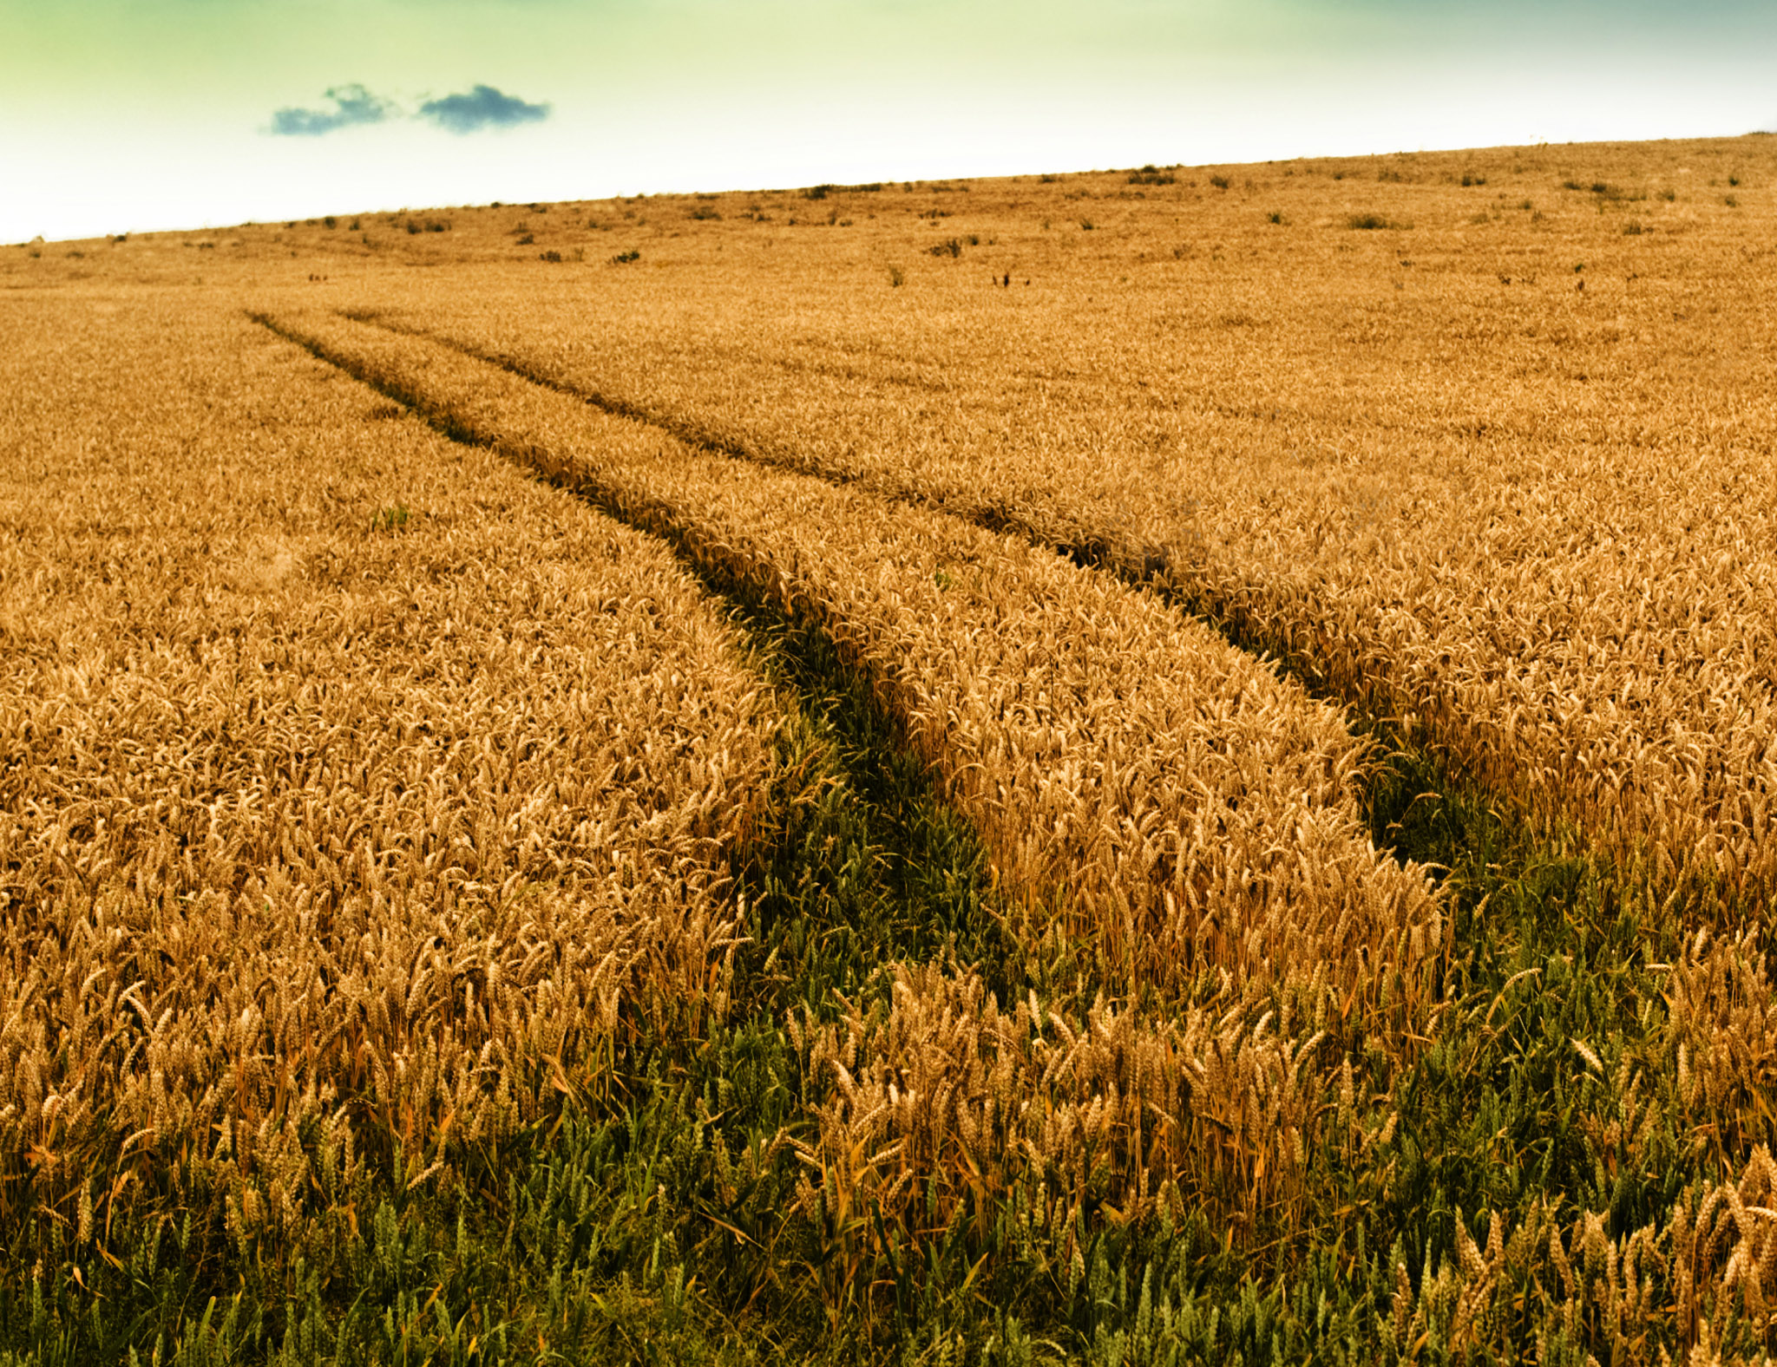

Slide 2


Slide 3


Slide 4

Ruth’s BIG IDEAS
Redemption
Returning home
Kindness

Slide 5
The backdrop
“The days when the Judges ruled” (v1)

Slide 6
The family
Elimelech – “God is my king”
Naomi – “Sweet”

Slide 7
The loss
Husband, two sons, homeland, security

Slide 8
The turning point for naomi

Slide 9
The turning point for ruth

Slide 10
Changing your name?

